Slide 1

Monitoring Activities
Notes:
Hello, and welcome to the session on Monitoring Activities. This presentation will provide you with an overview of how internal controls are evaluated to ensure they are adequate and properly functioning to mitigate the risks to achieving our objectives.

Slide 2


Monitoring
Ongoing
Separate
1
Notes:
Monitoring refers to the ongoing evaluation of internal control components to determine whether they are present and effective. There are two types of evaluation processes that we utilize here at SUNY: ongoing and separate.
Ongoing evaluations are those that take place at every level of an organization. They are done on a continuous basis, with any detected weaknesses reported up through the management chain to be addressed in a timely manner.
Separate evaluations are conducted on a periodic basis by someone independent from the process being evaluated. These are more in-depth, with weaknesses reported to senior management to develop a corrective action plan.

Slide 3
Monitoring
Staff
Supervisors
Department Managers
Senior Administration
2
Notes:
Everyone is responsible for ongoing monitoring activities.
Staff members should be monitoring their own work to ensure it is being completed properly, correcting any errors they identify before providing their work to higher levels for review. These individuals have the best vantage point for detecting weaknesses in control activities.
Supervisors monitor all activities and transactions in their unit for a number of reasons: to ensure staff members are performing their assigned responsibilities, control activities are functioning properly, the unit is accomplishing its goals, the unit’s control environment is appropriate, communication is open and sufficient, and risks and opportunities are identified and properly addressed.
Department managers assess how well control activities are functioning and how well supervisors are monitoring their units.
Senior administration focuses their monitoring efforts on the major divisions of an organization, putting more emphasis on monitoring the achievement of the organization’s goals. This group also monitors the risks and opportunities that exist within the internal and external environments.

Slide 4

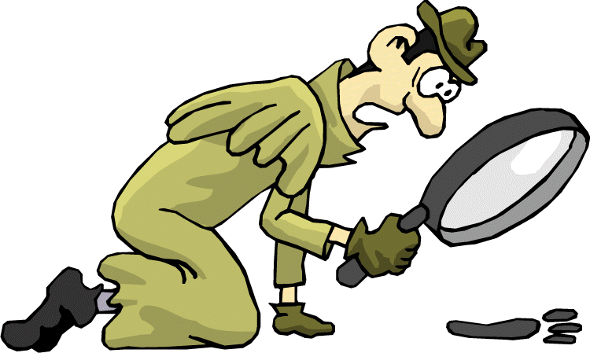
Monitoring
Control Environment
Procurement
HR/Payroll
Revenue/Cash Management
Computer Operations
Disaster Planning & Recovery
Property Control
Financial Aid
Pre-determined High Risk Areas
3 Year Cycle
Internal Control Officer
3
Notes:
The Internal Control Officer is responsible for conducting periodic, separate reviews of internal control activities. As part of the Internal Control Program, SUNY has identified eight areas that pose the highest risks to our operations: HR and payroll practices, financial aid, computer operations, procurement, revenue and cash management, property control, disaster planning and recovery, and the general control environment.
The control activities within these eight areas are required to be evaluated every three years. Any weaknesses identified are communicated to the respective department managers, who is responsible for developing corrective action plans to addresses these weaknesses. Each campus’ Internal Control Officer reports their 3-year evaluation plan to the SUNY Internal Control Officer at System Administration on an annual basis as part of the internal control certification process.

Slide 5

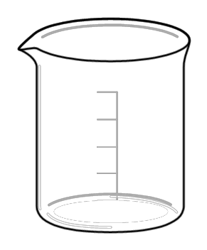
Monitoring
International Programs
Athletics
Environmental Health & Safety
Other High
Risk Areas
Campus X
Campus A
Campus Y
Campus B
Campus Z
Campus C
4
Notes:
In addition to the pre-determined high risk areas, each campus is also responsible for identifying and evaluating other areas they believe are of high risk and should be included in their review cycle. SUNY’s Internal Control Officer collects this information through the annual certification process, and identifies common areas that multiple campuses have identified. These additional areas help System Administration determine opportunities to provide additional guidance to campuses.

Slide 6

Monitoring
Internal Audit
External Audit
5
Notes:
Control activities are also evaluated and monitored through audits.
Internal audits are conducted by the Office of University Audit, or if applicable, a campus’ internal auditor. External audits are conducted by a number of organizations, such as the Office of the State Comptroller or an external CPA firm. These entities are responsible for conducting an independent assessment of control activities over specified areas to provide senior management with assurance the controls are adequate and effective. Findings and recommendations are communicated to senior management to be addressed.
While these functions also serve as a monitoring tool, it is important to note they are not to be considered a replacement for an internal control program. However, your Internal Control Officer can certainly leverage the findings and recommendations and rely on work recently completed by an auditor over a specific area.

Slide 7
Questions?
Thank You!
Created by the Office of the University Controller, SUNY System Administration
Notes:
This concludes the presentation on monitoring activities. Thank you for doing your part in continuously monitoring the controls in your area. If you have any questions or concerns, please contact your internal control officer.

